Slide 1

EXPONENTIAL DISTRIBUTUION
SANTOSH CHHATKULI

Slide 2
Introduction
The exponential distribution is a continuous probability distribution used to model the time we need to wait before a given event occurs. It is the continuous counterpart of the geometric distribution, which is instead discrete.
It is the probability distribution that describes the time between events in a Poisson point process i.e., a process in which events occur continuously and independently at a constant average rate λ.
It is mostly used in product reliability.

Slide 3
Exponential distribution may be used to answers the following questions.
How much time will elapse an earthquake occurs in a given region?
How long do we need to wait before a customer enters our shop?
How long will it take before a call centre receive the next phone call?
How long will a piece of machine work without breaking down?
How long battery in the mobile device lasts before it is replaced?

Slide 4
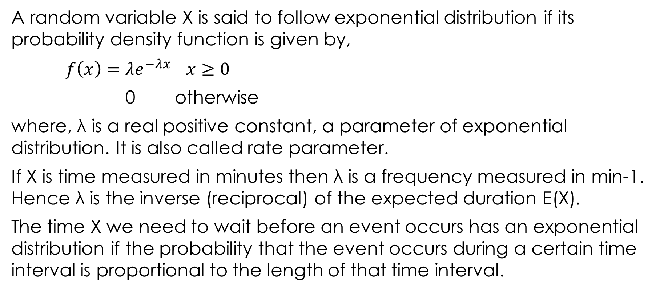
Probability Density Function
A random variable X is said to follow exponential distribution if its probability density function is given by,
$f\left(x\right)=λe^{−λx}$ $x≥0$
0 otherwise
where, λ is a real positive constant, a parameter of exponential distribution. It is also called rate parameter.
If X is time measured in minutes then λ is a frequency measured in min-1. Hence λ is the inverse (reciprocal) of the expected duration E(X).
The time X we need to wait before an event occurs has an exponential distribution if the probability that the event occurs during a certain time interval is proportional to the length of that time interval.

Slide 5
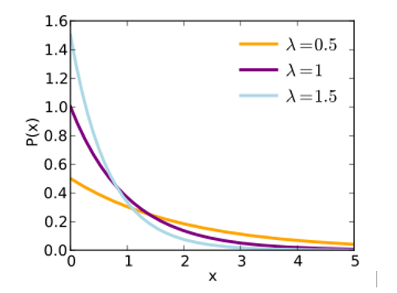
Graph of exponential distribution

Slide 6
Mean of Exponential Distribution

Slide 7
Variance of Exponential Distribution

Slide 8
Cummulative density function of Exponential Distribution
The cummulative distribution function (CDF) of an exponential distribution is given by,

Slide 9
Relationship between Exponential Distribution and Poisson Distribution
The exponential distribution is closely related to Poisson distribution. It is the probability distribution that describes time between events in a Poisson process.
While the exponential distribution models time between successive events over a continuous time period, the Poisson distribution deals with events that happen over a fixed period of time.
The number of times the event will happen in an interval (0, t) is Poisson distribution if,
the events can happen more than one time
if the time elapsed between two events is exponentially distributed
the events are independent of previous events.

Slide 10
Example:
Number of breakdowns of server in a given interval of time is Poisson process while the time in between breakdown of servers is given by exponential distribution.
Number of request of file in a server in an interval (o, t) is Poisson distribution while time between request is an exponential distribution.
Number of particular electronic device failed in a given interval of time (o, t) follows Poisson distribution while time between failure of components follows exponential distribution.

Slide 11
Numerical
1. An electronic component is known to have a useful life represented by an exponential density with failure rate of 10-5 failures per hour. what is the mean and variance of time to failure.
2. Suppose that the length of a phone call (in mins) in a phone booth is an exponential random variable X with decay parameter = 1/12 min-1. If someone arrives at a phone booth just before you arrive, find the probability that you will have to wait
less than 5 minutes
greater than 5 minutes
between 5 and 10 minutes

Slide 12
3. In a large corporate computer network, user log-ons to the system can be modeled as a Poisson process with a mean of 25 log-ons per hour. What is the probability that there are no log-ons in an interval of six minutes?
4. The time between the arrival of electronic messages at your computer is exponentially distributed with a mean of two hours.
(a) What is the probability that you do not receive a message during a two-hour period?
(b) If you have not had a message in the last four hours, what is the probability that you do not receive a message in the next two hours?
(c) What is the expected time between your fifth and sixth messages?

